Slide 1
Giving Presentations
Workshop
DR RABIA KHAN

Slide 2
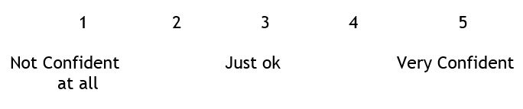
Presentations
  How confident are you that you can deliver a presentation effectively?

Slide 3
Presentations
Your experience

Slide 4
Presentations
How to Cure & Improve Performance
https://www.youtube.com/watch?v=-sQvr9lo4Jk

Slide 5
Presentations
  Nancy Duarte – Structure of greatest presentations/communicators:
  https://www.youtube.com/watch?v=1nYFpuc2Umk
  Nancy Duarte – 5 rules
  https://www.youtube.com/watch?v=hT9GGmundag

